Slide 1
STM32MP1 hands on
System Power Modes
rev 0.1

Slide 2
Content
Purpose of this presentation is to give to STMicroelectronics platform developers insight/knowledge/tips about STM32MP1 System Power Modes and in particular Low Power Modes.
"Hands on" means learning by doing.
This presentation describes for this topic the following sections:
Learning program: What are the objectives and benefits of this training. What is the overall plan and expected duration.
Prerequisites: What is mandatory to study, to have (in term of material) and knowledge (other Training, other Hands On, etc...) before starting this training.
Theoretical school: Documentation reference (to be consulted on request), self learning or presentation to follow.
Practicing school: Learning by doing part (sequence of exercises and practical work).
Evaluation: How to make sure all the objectives of the training were learnt ?

Slide 3
Learning program

Slide 4
Objectives
Power modes on STM32MP1
Power mode control
(STM32MPU OpenSTLinux distribution, STM32Cube HAL)
Power consumption measurements

Slide 5
Benefits
The benefits for the trainee are:
Understand the various power modes on STM32MP1 Series devices.
Be able to activate power modes using STM32MPU OpenSTLinux distribution and STM32Cube HAL commands.
Get started with STM32MP1 Series Evaluation board power measurements.

Slide 6
Plan
Architecture
- System power
- Clocking
- Debug
Evaluation Board
(45mn)
Lab1:
(20mn)
Lab2:
(20mn)
Lab3: (*)
(20mn)
Lab4:
(30mn)
Lab5:
(35mn)
Different power modes on A7 MPU
using STM32MPU OpenSTLinux
(M4 in CStop)
Control M4,
wakeup A7
using rpmsg
Run mode
LP-Stop mode
DDR Self Refresh
V_{DDCORE} = 1.2V
LPLV-Stop mode
DDR Self Refresh
V_{DDCORE} = 0.9V
Standby mode
DDR Self Refresh
DDR Off
V_{DDCORE} = 0V
Run mode
DDR Self Refresh
V_{DDCORE} = 1.2V
System power mode
A7 power mode
A7 CRun
A7 CSleep
A7 CStop
A7 CStop
A7 CStop
A7 CRun/CStop
M4 power mode
M4 CStop
M4 CRun, CStop
Lab3 is not available at this stage without recompilation of the distribution using attached patch (cf Lab3 section)

Slide 7
Prerequisites

Slide 8
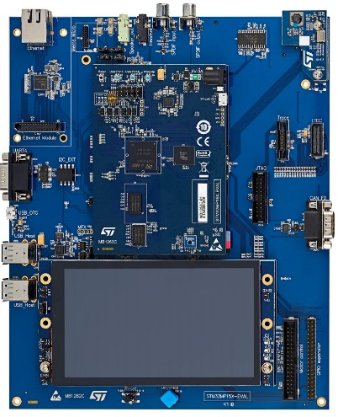
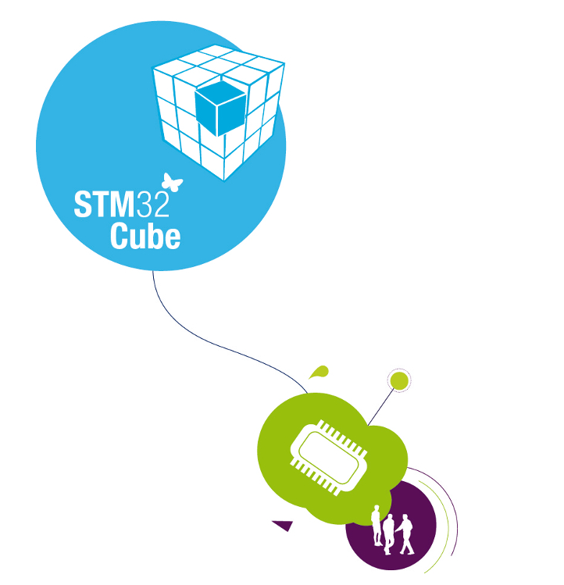

Prerequisites 1/1
STM32MP157C-EV1 evaluation board with STPMIC1x regulator and DDR3
Evaluation Board (MB1262+MB1263)
Windows PC with Console through ST-Link
(or a Linux PC)
Multimeter
System Workbench IDE(SW4STM32) installed.
STM32MPU OpenSTLinux Distributions
STM32MP1Starter package
> hello.
> …
0.00
A V
A COM V

Slide 9
Theoretical school

Slide 10
Theoretical school
AN5109: STM32MP1 series Using Low power modes
RM0436: Reference Manual (PWR and RCC sections)
UM2535: Evaluation board User Manual
STPMIC1x datasheet
STM32 MP1 Wiki : http://wiki.st.com/stm32mpu/index.php/Main_Page

Slide 11
Power Architecture – on our evaluation board
Using External Power Regulator (STPMIC1x)
System power modes are set by PWR manager based on MPU and MCU power modes
Clock manager
STM32MP15x
Shared by A
7
S
&
A
7
NS
&
M
4
V_{SW} domain (*)
. RTC, LSE, AWU, tamper
. Backup registers, Reset
. Backup and Retention RAMs and regulators
STPMIC1x
External
Power Regulator
PWR_ON
control pin
PWR manager
MPU power state
MCU power state
Supplies
Dual Cortex – A7
(master)
Cortex-M4
(co-processor)
External DDR3 2x16bits
(*) powered by V_{BAT} when V_{DD} is not present)
Notes:
Using an external power regulator with STM32MP1 Series is a key difference in power architecture (vs. having an integrated power regulator in STM32 MCUs).
This can be a ST STPMIC1x device or some discrete components.
The available power modes at system level are based on the respective power modes on each sub-systems (MPU, MCU)
The device include a V_{SW} backup domain. This power domain has its own integrated regulators (retention regulator & backup regulator) when powered by V_{BAT}

Slide 12
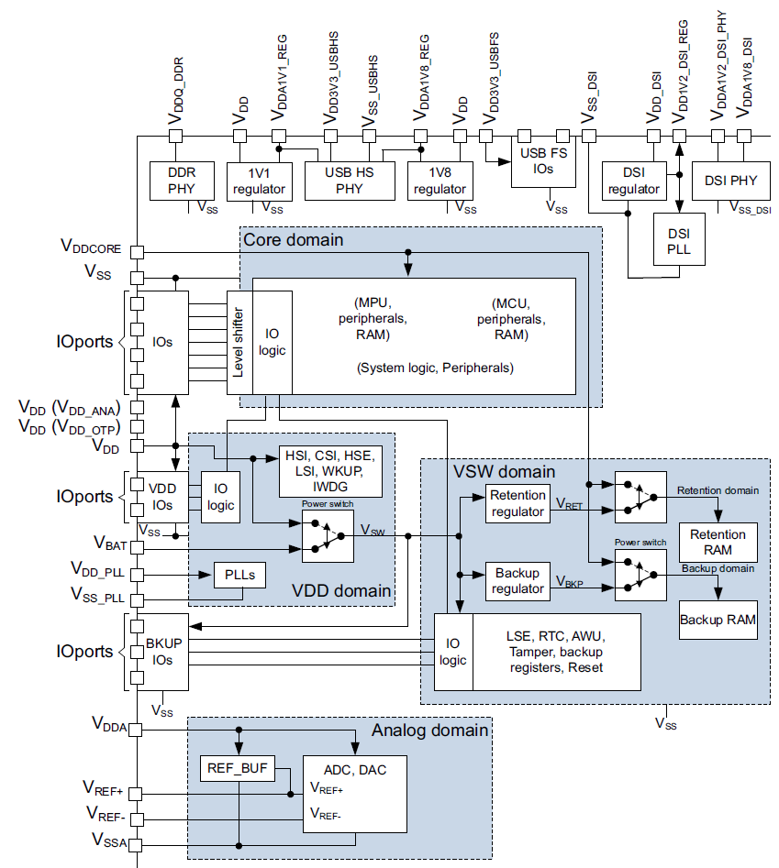
Power schemes
V_{DDCORE} value is directly related to the low power modes definition
1.20 V^{(*)} [1.18 V to 1.25 V]: Run, Stop, LP-Stop
0.90 V ^{(*)} [0.85 V to 1.25 V]: LPLV-Stop
0 V ^{(*)} [0 V to 0.75 V]: Standby
^{(*)} Typical values
Other supply voltages please refer to the Datasheet
Notes:
V_{DDCORE} is the main supply whose value is directly affected by the power modes.
V_{DD} can also been switched off and replaced by an optional V_{BAT} supply (VBAT power mode)
Analog and interfaces (DSI, USB, DDR) have some dedicated power supplies.

Slide 13
STM32MP1 Power modes Overview
MPU and MCU sub-system power modes
CRun V_{DDCORE} power On, clock On
CSleep V_{DDCORE} power On, CPU clock Off
CStop V_{DDCORE} power On, CPU sub-system clock Off
CStandby (applicable to MPU only) V_{DDCORE} power On or Off (only if system in Standby),
CPU sub-system clock Off, CStandby is not supported in STM32MPU OpenSTLinux Distributions
 | Crun | CSleep | CStop MPU PDDS=0 | CStop MPU PDDS=1 CSTBYDIS=1 | CStandby
CRun
CSleep | Run
CStop MCU PDDS=0 |  |  | Stop, LP-Stop, LPLV-Stop
CStop MCU PDDS=1 |  |  |  | Standby
MPU
System Power modes
(based on MPU and MCU power modes)
MCU
Not supported in STM32MPU OpenSTLinux Distributions
MCU PDDS bit in PWR_MCUCR register (0: Keeps Stop mode when MCU enters CStop, 1: Allows Standby mode when MCU enters CStop)
MPU PDDS bit in PWR_MPUCR register (0: Keeps Stop mode when MPU enters to CStop, 1: Allows Standby mode when MPU enters to CStop. When CSTBYDIS = 0 allows MPU to enter CStandby mode.)
CSTBYDIS bit in PWR_MPUCR register (0: MPU CStandby mode enabled, 1: MPU CStandby mode disabled)
Notes:
In order to be in Standby mode (have the V_{DDCORE} switched off), both sub-systems must be allowed to shut off the V_{DDCORE} supply. So MPU should be in CStandby mode or CStop mode with MPU PDDS=1 and CSTBYDIS=1, and the MCU in CStop with PDDS bit =1 (allowing system to go to Standby and switch off V_{DDCORE}).
Note that MPU CStandby is not supported in the STM32MPU OpenSTLinux Distributions because it may cause some configuration issue at wakeup time with MCU since boot peripherals are not accessible on ST boards after CStandby due to wiring choices (cf AN5109 for more details)
There are several system Stop modes which are detailed in next slide.

Slide 14
STM32MP1 System Power modes
System Power Mode | V_{DDCORE} | Clocks | Wakeup sources (not all sources are available in the Linux environment|)
Run | Nominal (typ. 1.2V) | ON | All
Stop | Nominal (typ. 1.2V) | MCU and MPU sub-systems clock OFF | DBG, PVD, AVD, USBH, OTG, CEC, ETH, MDIOS, USARTx, I2Cx, SPIx, TEMP, LPTIMx, GPIOs ( + VBAT mode sources)
LP-Stop | Nominal (typ. 1.2V)
LPLV-Stop | Reduced (typ. 0.9V) |  | PVD, AVD, TEMP, GPIOs ( + VBAT mode sources)
Standby | 0 V |  | 6 GPIO wakeup pins ( + VBAT mode sources)
VBAT | RTC and backup domain supply provided by optional V_{BAT} supply when V_{DD} is not present |  | BOR, VBATH/VBATL, TEMPH/TEMPL, LSE CSS, RTC/Auto wakeup, Tamper pins, IWDGx
LP-Stop drives control pins PWR_LP and/or PWR_ON to 0, allowing external regulator to switch off some power supplies if needed (ex: DDR resistance termination power supply)
LPLV-Stop requires that the external power regulator can lower the V_{DDCORE} supply (to reduce the STM32MP1 consumption) The STPMIC1 power regulator offers this feature
In Standby mode V_{DD} is still ON.
Notes:
The power consumption reduction for the various mode is achieved through the following means:
Un-clocking the CPUs and the sub systems
Switching off some system power supplies by controlling the external regulator via PWR_LP/PWR_ON control pins (only PWR_ON is needed when using STPMIC1x)
Reducing the V_{DDCORE} voltage
The available wakeup sources depends on the system power mode (see wakeup source depending on system operating mode in the STM32MP1 reference manual). The deeper low power mode, the less number of wakeup sources.

Slide 15
Linux Power commands mapping
Predefined Linux commands are mapped to the STM32MP1 System power modes according below table.
A software mechanism is implemented to ensure that the low power mode and the activated wake-up source are consistent (ex: cannot enter LPLV-Stop if I2C wakeup source is enabled)
Linux command (Linux kernel state) | STM32MP1 System power mode | comment
‘mem’ (Suspend-to-RAM) (*) | Stop or LP-Stop (Stop or LP-Stop predefined in secure monitor device tree) | LP-Stop: driving external PWR_LP/PWR_ON permits to design custom strategy for external regulator. Typical application is to switch-off DDR3 termination supply (VTT) in DDR3 32 bit design
 | LPLV-Stop | LPLV-Stop: save power thanks to power retention. Can be suitable for application with aggressive power constraint and tolerant with limitation of wakeup source.
 | Standby | Standby saves more power at the expense of wakeup time
‘shutdown’ | Standby or Off/VBAT (Standby or Off/VBAT predefined in secure monitor device tree) | Wakeup sequence and applicative impact guide the choice between Standby and Off
(*) selection between Stop/LP-Stop, LPLV-Stop or Standby is done automatically based on which wake-up source is activated and available on those low power modes.(ex: if I2C wake-up is activated will go to Stop/LP-Stop. Cf previous slide)

Slide 16
Clock and low power modes 1/2
OSC32_IN
Vsw (Backup) Domain
OSC32_OUT
LSE
to RTX/AWU
High level description of the clock tree structure.
In particular dividers are not represented
(cf. Reference Manual for details)
VDD Domain
to IWDG
LSI
hse_clk
OSC_IN
hse_clk
hsi_clk
to MPU
sub-system clock
OSC_OUT
HSE
p
hse_clk
hsi_clk
PLL1
hse_clk
to AXI
sub-system clock
HSI
hsi_clk
hsi_clk
p
q
r
PLL2
to GPU
CSI
csi_clk
to DDR
hse_clk
hse_clk
hsi_clk
to MCU
sub-system clock
hsi_clk
csi_clk
p
q
r
csi_clk
PLL3
Periph Kernel clock selection
to peripherals kernel clocks
hse_clk
p
q
r
hsi_clk
PLL4
to ETH/I2S/GTX
csi_clk
hse/hsi/csi/lsi/lse kernel_ck

Slide 17
Clock and low power modes 2/3
Mode | Clock status
 | PLLs | Sub-system | CPU | Periph.
 |  |  |  | bus clk | kernel clk
CRun | On⁽¹⁾ | On | On | On ⁽²⁾ | On ⁽²⁾
CSleep | On⁽¹⁾ | On | Off | On ⁽³⁾ | On ⁽³⁾
Stop | Off | Off | Off | Off | Off/On ⁽⁴⁾⁽⁵⁾
Unless Oscillator used instead
According to RCC PERxEN
According to RCC PERxEN and PERxLPEN
In order to allow the I2Cs or U(S)ARTs to work in CStop or system (LP-)Stop mode, the user must select an oscillator as kernel clock: hse_ker_ck, hsi_ker_ck or csi_ker_ck according to RCC PERxEN. The selected oscillator(s) is provided to the peripheral when the peripheral generates a kernel clock request.
The oscillator(s) remain activated in Stop mode if the xxxKERON=‘1’ ,allowing immediate delivery of the clock on wakeup from Stop or on peripheral kernel clock request.
Notes:
In Stop mode, the sub-system clocks are off since all PLL are Off and hsi_ck, hse_ck, csi_ck are gated. However kernel clocks (hsi_ker_ck, hse_ker_ck, csi_ker_ck) can be kept active according to some peripheral needs (U(S)ART, I2C, SPI).

Slide 18
Clock and low power modes 3/3
On exit from Stop/LP-Stop/LPLV-Stop modes:
the ‘clock restore’ HW feature will reconfigure PLL1&PLL2 settings.
Need to reconfigure other PLLs if needed.
The MCU is restarted on HSI clock (HSI frequency “HSIDIV setting” is kept same as before Stop mode), and MCUDIV is set back to its reset value.
On exit from Standby mode:
Waking up on MPU is equivalent to a reset (starting from HSI, all clocks settings are to be handled by MPU SW)
Waking up on MCU only (MCU_BEN=1, MPU_BEN=0 in RCC_MP_BOOTCR register), user must ensure that all clocks settings are handled by MCU SW.

Slide 19
Debug aspects during low power modes
A low power mode emulation that keeps debug capability while in low power mode is supported (controlled by DBGSLEEP, DBGSTOP and DBGSTBY bits in DBGMCU_CR register).
When entering CSleep mode on MPU side, the debug clock is always kept active (so DBGSLEEP bit only applies for MCU)
Caution: using low power emulation modes has a significant impact on the power savings (various clocks and power supply being kept on). Such modes should only be used for debugging purposes. Power consumption measurements are not relevant while using low power mode emulation.
The Hardware Debug Port (HDP) allows the observation of internal signals that can be used to debug the entry in and the exit from low power modes.

Slide 20
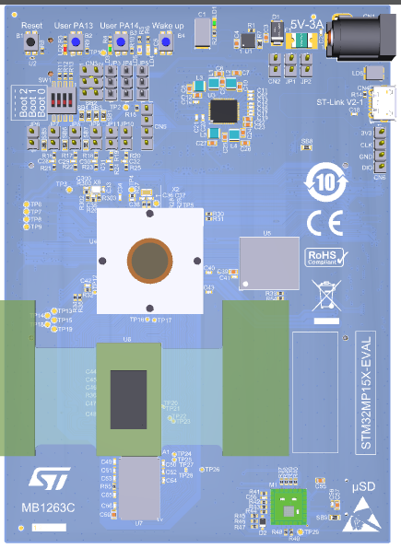
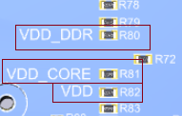
Evaluation board MB1263C STM32MP157C-EV1 (STPMIC1x, DDR3)
It is NOT possible to directly measure consumption on the board⁽¹⁾.
In those labs we propose to modify the board ⁽¹⁾ and measure
V_{DDCORE,} V_{DD,} V_{DD_DDR} (V_{DD_DDR} is the supply to DDR3 memory and STM32MP1 DDR_PHY interface)
STPMIC1 external regulator allows below modes:
LP-Stop mode with switching off DDR resistance termination.
LPLV-Stop mode with VDDCORE reduced to 0.9V.
(!! need recompilation of STM32MPU OpenSTLinux to allow LPLV-Stop mode)
Some 0Ω shunt resistors (R80, R81, R82) on the back side of the board are present on power supplies and can be replaced by 0.1Ω resistors on VDDCORE, VDD, VVDQ_DDR to measure the voltage and deduce current.

Slide 21
Constraints due to STM32MPU OpenSTLinux Distributions
The provided distribution Starter package is based on “ev1” Weston graphical framework which requires the mother board (MB1262) to boot correctly
The measurements will be provided on mother+daughter board (MB1262+MB1263).
The distribution used is the labs is: openstlinux-4.19-weston-mp1-19-02-20 “ev1”
The example of Lab5 based on: STM32Cube_FW_MP1_V0.6.0
We will also provide the current measurement on an internal (not delivered) “ed1” non Weston, emmc patched distribution to remove unwanted VDD current:
VDD current being used on mother board due to Weston distribution
eMMC VDD current due to daughter board not optimized for VDD current consumption (we patched the distribution to de-activate eMMC)

Slide 22
Power consumption on Evaluation board with STM32MPU OpenSTLinux Distributions
System power modes
I_VDDCORE
VDDCORE=1.2V
I_VDD
VDD=3.3V
I_VDDQ_DDR
VDD_DDR=1.34V
total
CSleep
(Linux prompt after boot) (*)
400 mW
90 mW
220 mW
324 mW
21 mW
220 mW
565 mW
Measurements done on 1 part at ambient temp, using OpenSTLinux starter package kernel 4.19.
Results may not be representative of typical samples. They are provided as indication only (applies to all following slides).
LP-Stop
(DDR SR, term. resistors OFF)
32 mW
32 mW
75 mW
32 mW
7 mW
75 mW
114 mW
LPLV-Stop
(need STM32MPU OpenST Linux recompilation)
(DDR SR, term. resistors OFF)
VDDCORE=0.9V
12 mW
32 mW
75 mW
12 mW
7 mW
75 mW
94 mW
VDDCORE=0V
Standby
(DDR SR, term. resistors OFF)
0 mW
22 mW
75 mW
0 mW
0.5 mW
75 mW
75.5 mW
VDDCORE=0V
VDDQ_DDR=0V
Standby
(DDR OFF)
0 mW
11.5 mW
0 mW
0 mW
0.5 mW
0 mW
0.5 mW
(*) At the Linux prompt the system is approx. 90% in CSleep and rest of the time distributes IRQ and threads to A7 cores.
Measurement done on mother+daughter boards (MB1262+MB1263), “ev1” Weston starter package distribution. Done in this lab
Measurement on MB1263 “ed1-non Weston” distribution with eMMC de-activation patch Not available for the Lab

Slide 23
A little Quiz…
Can you fill the missing cells ?
System Power modes (RUN, Stop, LP-STOP, LPLV-Stop, Standby)
MPU
 | CRun | CSleep | CStop PDDS=0 | CStop PDDS=1 CSTBYDIS=1 | CStandby
CRun
CSleep | ??
CStop PDDS=0 |  |  | ??
CStop PDDS=1 |  |  |  | ??
MCU

Slide 24
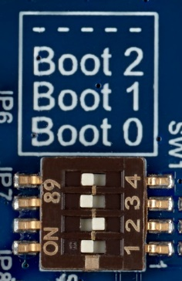
System setup
Labs do not requires Linux PC or Linux emulation on Windows PC.
However a SD Card with “STM32MP1Starter Package is required
You will need the Evaluation daughter board (MB1263) … no need for the mother board (MB1262)
Power supply the board and connect ST-Link USB port to the Host PC.
Run a console with Baud rate: 115200 (data 8bit, no parity, 1bit Stop, no Flow control)
Make sure SW1 switches are in SD Card boot configuration

Slide 25
Practicing school

Slide 26
Lab 1

Slide 27
Practicing school: Lab1 1/3
Duration: 20mn
Objective: A7 in CRun/CSleep mode, M4 in CStop (MCU HOLD_BOOT)
Understand MCU HOLD_BOOT principle
Measure the Linux Idle mode consumption (CSleep + Task Rescheduler)
Measure the A7 CRun mode consumption (SW is a ‘For’ loop that takes 100% of CPU)

Slide 28
Practicing school: Lab1 2/3
MCU HOLD_BOOT principle
The MCU can be kept in HOLD_BOOT after each MCU reset
From Power Modes point of view, this is equivalent to a MCU CStop. It will be used in these labs as a way to have MCU in CStop without having to run code on M4 MCU.
The MCU can be put in HOLD_BOOT at any time by the MPU:
Set BOOT_MCU=0 in the RCC Global Control Register (RCC_MP_GCR).
0: The MCU will be set in HOLD_BOOT when the next MCU core reset occurs. (default after reset)
1: The MCU will not be in HOLD_BOOT mode when the next MCU core reset occurs.
Then, reset the MCU by writing 1 in RCC_MP_GRSTCSETR.MCURST
From Linux standpoint, this can be done by remoteproc stop service
cat /sys/class/remoteproc/remoteproc0/state to check if a M4 firmware is running
If a M4 firmware is running, we halt the remote processor and return it to the “offline” state
echo stop > /sys/class/remoteproc/remoteproc0/state
Notes:
From Linux standpoint, if no M4 firmware running, no firmware in /lib/firmware will prevent the remoteproc to be started.
In that case, the MCU will stay in HOLD_BOOT and will be considered as being in CStop mode

Slide 29


Practicing school: Lab1 3/3
Measure the Linux Idle mode (CSleep + Task Rescheduler)
Run the following command:
the ‘For’ loop takes 100% of 1 A7 CPU and prevents Linux to go in Sleep mode in order to measure correctly the A7 CRun consumption (both A7 are in WFI during Linux Idle task).
2) Make measurements (CSleep is measurement at Linux prompt after boot)
Board $> cat /sys/class/remoteproc/remoteproc0/state (should echo “offline”)
If the return value is not “offline: we need to put M4 in HOLD_BOOT
Board $> echo ‘stop’ > /sys/class/remoteproc/remoteproc0/state
Board $> while true; do echo '‘”> /dev/null; done
Use case At ambient temp, Typ voltage | V_{DDCORE}/V_{DD}/V_{DD_DDR} Expected (mA) | V_{DDCORE}/V_{DD}/V_{DD_DDR} Measured (mA)
Linux prompt after boot (~Csleep) | 333 / 27 / 165 | / /
 | 270 / 6.5 / 165 (*)
A7 CRun – M4 HOLD_BOOT | 385 / 27 / 165
 | 342 / 4.5 / 165 (*)
(*) Measurement on MB1263 “ed1-non Weston” distribution with eMMC de-activation patch

Slide 30
Lab 2

Slide 31
Practicing school: Lab2 1/2
Duration: 20mn
Objective: Entering System in LP-Stop
A7 in CStop mode, M4 in CStop (MCU HOLD_BOOT)
Understand the Linux command
As explained earlier (cf slide 15), entering ‘mem’ Linux command will put the system in the deeper possible low power mode according enabled wake-up sources (cf slide 14 for list of wake-up sources)
Need to activate wake-up source to prevent entering into a deeper low power mode than LP-Stop (ex: Standby)
→ the UART wake-up source will be enabled in this Lab
Measure the LP-Stop mode consumption
Wake up from LP-Stop mode using any keyboard input (uart interrupt)
Notes:
Note: The I2C wake-up source is only used to enter the targeted low power mode (LP-Stop instead of Standby) but in this lab we use another wake-up source to wake-up the system (the “Wake up button” interrupt on STPMIC1x)

Slide 32
Practicing school: Lab2 2/2
Enable UART wakeup source
Measure the STM32MP1 in System LP-Stop mode
System LP-Stop is reached on the platform by setting the Linux Kernel in “Suspend-To-Ram” state
This is done by writing ‘mem’ into /sys/power/state
LP-Stop mode will switch off the DDR3 resistance termination supply (VTT)
Enter LP-Stop mode:
Wakeup from LP-Stop mode typing any keyboard key.
Board $> echo enabled > /sys/devices/platform/soc/40010000.serial/tty/ttySTM0/power/wakeup
Board $> echo enabled > /sys/devices/platform/soc/40010000.serial/power/wakeup
Board $> cat /sys/class/remoteproc/remoteproc0/state (should echo “offline”)
If the return value is not “offline: we need to put M4 in HOLD_BOOT
Board $> echo ‘stop’ > /sys/class/remoteproc/remoteproc0/state
Board $> echo mem > /sys/power/state (put A7 in CStop and System in LP-Stop, DDR in SR)
Use case At ambient temp, Typ voltage | V_{DDCORE}/V_{DD}/V_{DD_DDR} Expected (mA) | V_{DDCORE}/V_{DD}/V_{DD_DDR} Measured (mA)
System LP-Stop (A7 CStop– M4 CStop) | 27 / 9.8 / 57 | / /
 | 27 / 2.2 / 57 (*)
(*) Measurement on MB1263 “ed1-non Weston” distribution with eMMC de-activation patch

Slide 33
Lab 3

Slide 34
Practicing school: Lab3 1/2
Duration: 20mn
Objective: Entering System in LPLV-Stop
A7 in CStop mode, M4 in CStop (MCU HOLD_BOOT)
Understand the Linux command
Need to activate wake-up source to prevent entering into a deeper low power mode than LPLV-Stop (ex: Standby) → the GPIO PA13 wake-up source will be enabled in this Lab
By default in the device tree the wake-up from GPIO is not activated in order to go into the deepest low power mode. It is not possible to activate dynamically.
It is possible to boot in “A7 example” to activate the GPIO wake-up.
Measure the LPLV-Stop mode consumption
Wake up from LPLV-Stop mode using PA13 user button on Eval Board
This lab is not available at this time on OpenST Linux Starter package without modification of the device tree using attached patch and recompilation. (cf notes)
Notes:
The LPLV-Stop mode cannot be reached on the current STM32MPU OpenSTLinux Distributions Starter package since GPIO wakeup for LPLV-Stop has not been implemented in the current configuration.
However it is possible to update the device tree and recompile using attached patch.

Slide 35
Practicing school: Lab3 2/2
Enable PA14 wakeup source
Boot in “stm32mp157c-ev1-a7-examples-sdcard” mode .. By selecting boot menu ‘2’ during boot sequence (the boot sequence is rather fast. Need to rapidly choose the boot selection when asked)
STM32MP1 in System LPLV-Stop mode
System LPLV-Stop is reached on the platform by setting the Linux Kernel in “Suspend-To-Ram” state
This is done by writing ‘mem’ into /sys/power/state
LPLV-Stop mode will switch off the DDR3 resistance termination supply (VTT) and set V_{DDCORE} to 0.9V
Enter LPLV-Stop mode:
Wakeup from LP-Stop mode using user PA13 button
Board $> cat /sys/class/remoteproc/remoteproc0/state (should echo “offline”)
If the return value is not “offline: we need to put M4 in HOLD_BOOT
Board $> echo ‘stop’ > /sys/class/remoteproc/remoteproc0/state
Board $> echo ‘mem’ > /sys/power/state (put A7 in CStop and System in LPLV-Stop, DDR in SR)
Use case At ambient temp, Typ voltage | V_{DDCORE}/V_{DD}/V_{DD_DDR} Expected (mA) | V_{DDCORE}/V_{DD}/V_{DD_DDR} Measured (mA)
System LPLV-Stop (A7 CStop– M4 CStop) | 13.5 / 9.8 / 57 | / /
 | 13.5 / 2.2 / 57 (*)
(*) Measurement on MB1263 “ed1-non Weston” distribution with eMMC de-activation patch
Notes:
Once option ‘2’ selected to boot in ‘stm32mp157c-ev1-a7-examples-sdcard’ mode, you can see in the Linux window a message stating:
Select the boot mode
1: stm32mp157c-ev1-sdcard
2: stm32mp157c-ev1-a7-examples-sdcard
3: stm32mp157c-ev1-m4-examples-sdcard
Enter choice: 2
2: stm32mp157c-ev1-a7-examples-sdcard
Retrieving file: /uImage
…
Retrieving file: /stm32mp157c-ev1-a7-examples.dtb“

Slide 36
Quiz (better to be in Slide Show mode !!!)

Slide 37
A little Quiz… (click for answers if in Slide show mode)
How are the DDR3 resistance termination power supply switched off in LP-Stop mode ?
> The STM32MP15 when entering LP-Stop will toggle PWR_ON output control pin. This pin is connected to the external regulator (STPMIC1x) “PWRCTRL“ pin. When the “PWRCTRL“ pin toggles the STPMIC1x is switching its output supplies according pre-programmed settings. The pre-programmed setting for LP-Stop is to switch off VTT supply.
How to exit from LP-Stop mode?
> In LP-Stop mode, clocks are switched off. The system will wake-up through some enabled EXTI interrupts of event (DBG, PVD, AVD, USBH, OTG, CEC, ETH, MDIOS, USARTx, I2Cx, SPIx, TEMP, LPTIMx, GPIOs).
What about PLL settings ?
> HW Clock restore procedure reconfigures PLL1 and PLL2 settings automatically. The application has to reconfigure the PLL3 and PLL4 settings. (OK !!! That was not in the previous slides ☺ you can find this in the Reference Manual RCC section.)

Slide 38
Lab 4

Slide 39
Practicing school: Lab4 1/4
Duration: 20mn
Objective: Entering system in Standby mode with DDR in SR
Entering system in Standby mode with DDR Off
A7 in CStop+MPU_PDDS=1, CSTBYDIS=1, M4 in CStop + MCU_PDDS=1 (MCU HOLD_BOOT)
Understand the Linux command
Need to disable wake-up sources to allow entering into deepest low power mode (Standby)
in case starting from reboot, no need to disable any wake-up source.
Standby mode with DDR in SR is entered using the Linux « mem » command
Standby mode with DDR OFF is entered using the Linux « shutdown -h 0» command
Measure the Standby mode consumption
Wake up from Standby mode :
When DDR is OFF: Reload kernel and reboot from scratch.
When DDR is in SR: kernel still in DDR, resume kernel.
Notes:
Entering VBAT mode (VDD Off) would be possible by recompiling the secure monitor.

Slide 40
Practicing school: Lab4 2/4
Case 1: STM32MP1 in System Standby with DDR SR mode (shut off VDDCORE)
System Standby is reached on the platform by setting the Linux Kernel in “Suspend-To-Ram” state
This is done by writing ‘mem’ into /sys/power/state and have M4 in CStop with PDDS=1
Enter Standby mode
Wakeup from Standby mode using user wakeup button
Terminal is active again (can enter Linux commands)
Board $> cat /sys/class/remoteproc/remoteproc0/state (should echo “offline”)
If the return value is not “offline: we need to put M4 in HOLD_BOOT
Board $> echo ‘stop’ > /sys/class/remoteproc/remoteproc0/state
Board $> echo mem > /sys/power/state (put A7 in CStop and System in Standby, DDR in SR)
Use case At ambient temp, Typ voltage | V_{DDCORE}/V_{DD}/V_{DD_DDR} Expected (mA) | V_{DDCORE}/V_{DD}/V_{DD_DDR} Measured (mA)
System Standby (A7 CStop– M4 Cstop with PDDS=1) | 0 / 6.8 / 57 | / /
 | 0 / 0.15 / 57 (*)
(*) Measurement on MB1263 “ed1-non Weston” distribution with eMMC de-activation patch

Slide 41
Practicing school: Lab4 3/4
Case 2: STM32MP1 in System Standby with DDR off
System Standby with DDR off is reached on the platform by setting the Linux Kernel in “Shutdown” state
This is done by running the ‘shutdown –h 0’ command and have M4 in CStop with PDDS=1
Enter STM32MP1 in system Standby mode DDR off (Linux Kernel in “Shutdown”) :
Board $> cat /sys/class/remoteproc/remoteproc0/state (should echo “offline”)
If the return value is not “offline: we need to put M4 in HOLD_BOOT using below command
Board $> echo ‘stop’ > /sys/class/remoteproc/remoteproc0/state
Board $> shutdown –h 0 (put A7 in CStop with PDDS=1 and System in Standby, DDR Off)
Use case At ambient temp, Typ voltage | V_{DDCORE}/V_{DD}/V_{DD_DDR} Expected (mA) | V_{DDCORE}/V_{DD}/V_{DD_DDR} Measured (mA)
System Standby DDR off (A7 CStop– M4 Cstop with PDDS=1) | 0 / 3.5 / 0 | / /
 | 0 / 0.15 / 0 (*)
(*) Measurement on MB1263 “ed1-non Weston” distribution with eMMC de-activation patch
Wakeup from Standby mode using reset button... Linux reboot

Slide 42
Quiz (better to be in Slide Show mode !!!)

Slide 43
A little Quiz… (click for answers if in Slide show mode)
What are the values of V_{DDCORE} and V_{DD} in Standby mode ?
> V_{DDCORE} is Off, V_{DD} is On in Standby mode.
What must be done before entering low power system mode on M4 side ?
> The M4 cluster must be in a state allowing the system to enter the targeted power mode:
- M4 in CStop before entering in system Stop, LP-Stop or LPLV-Stop
- M4 in CStop with PDDS=1 before entering in system Standby
In VBAT mode what is still functional ?
> RTC, backup domain
(you can find this in the Reference Manual PWR section, or slide 14.)

Slide 44
Lab 5

Slide 45
Practicing school: Lab5 1/7
Duration: 35mn
Objective: Using low power mode with A7 and M4 (from STM32CubeMX example)
Understand how to set A7 in CStop only keeping M4 in CRun
Compare consumption with A7 and M4 in CRun
Understand how to wakeup A7 from M4 through rpmsg
Understand how to set M4 in low power modes from Linux console

Slide 46
Practicing school: Lab5 2/7
Lab5 steps:
Using STM32Cube “OpenAMP_TTY_echo_wakeup” example
→ Need to boot in “M4 example” mode
Step1: Load firmware, Start with A7 + M4 Measure conso (A7+M4)
Step2: Set A7 in CStop (linux ‘mem’ cmd) Measure conso (A7 CStop, M4 CRun)
Step3: Wakeup A7 with rpmsg from M4
Step4: Set M4 in CStop mode from Linux Using HAL_Enter_Stop() command on M4
Set M4 in CStop with PDDS=1 Using HAL_Enter_Standby() command on M4

Slide 47
Practicing school: Lab5 3/7
Step1: Loading STM32CubeMx M4 firmware
OpenAMP_TTY_echo_wakeup example is already available in the STM32MP1 Starter Package.
Boot and choose option “3” to assign M4 resources to Linux Resource manager driver
Go to the example folder and run the fw_cortex_m4.sh script (will load fw .elf and start Linux Remote Processor)
Read README file and fw_cortex_m4.sh to get more information on the example.
Enable the communication channel with M4 through rpmsg and verify it is ok
Board $>… during boot phase.. choose option 3: stm32mp157c-ev1-m4-examples-sdcard
Board $> cd /usr/local/Cube-M4-examples/STM32MP157C-EV1/Applications/OpenAMP/OpenAMP_TTY_echo_wakeup
Board $> ./fw_cortex_m4.sh start
Board $> stty -onlcr -echo -F /dev/ttyRPMSG0
Board $> cat /dev/ttyRPMSG0 &
Board $> echo "Hello Virtual UART0" >/dev/ttyRPMSG0
Use case At ambient temp, Typ voltage | V_{DDCORE} Expected (mA) | V_{DDCORE} Measured (mA)
M4 CRun + A7 CRun | 320 | /
Notes:
You can refer to Wiki to know more on OpenAMP and Linux Remote Processor framework.

Slide 48
Practicing school: Lab5 4/7
Step2: Set A7 in CStop with M4 CRun
Simply put A7 in low power mode using ‘mem’ command
Only the M4 is running
Board $> echo mem > /sys/power/state
Use case At ambient temp, Typ voltage | V_{DDCORE} Expected (mA) | V_{DDCORE} Measured (mA)
M4 CRun + A7 CRun | 92 | /

Slide 49
Practicing school: Lab5 5/7
Step3: Wakeup A7 with rpmsg from M4
From Step2 you need to press “wakeup” button (no need to rerun the commands from Step1)
Allow A7 mailbox wakeup capability
Set A7 in CStop (“mem” command) then wakeup after 10s from M4
After ~10s the A7 will wake up from Stop and the “*delay” message will show on console
Board $> echo enabled > /sys/devices/platform/soc/4c001000.mailbox/power/wakeup
Board $> echo "*delay" >/dev/ttyRPMSG0; echo mem > /sys/power/state

Slide 50
Practicing school: Lab5 6/7
Step4: Set M4 in CStop mode from Linux
M4 low power modes can be reached using the HAL commands (cf next slide)
This is predefined in the example “OpenAMP_TTY_echo_wakeup” using rpmsg to M4
Sending message “*stop” will set M4 into CStop running HAL_PWR_Enter_StopMode()
Sending message “*standby” will set M4 into CStop with PDDS=1 running HAL_PWR_Enter_StandbyMode()
Sending any new message through rpmsg will wake up M4
Board $> echo "*stop" > /dev/ttyRPMSG0
Or
Board $> echo "*standby" > /dev/ttyRPMSG0
Board $> echo “wakeup" > /dev/ttyRPMSG0
Use case At ambient temp, Typ voltage | V_{DDCORE} Expected (mA) | V_{DDCORE} Measured (mA)
M4 CRun + A7 CRun | 323
M4 CStop + A7 CRun | 306

Slide 51
Practicing school: Lab5 7/7
HAL commands for low power
Low power mode | Function | Input | Description
CSleep | HAL_PWR_EnterSLEEPMode | PWR_MAINREGULATOR_ON PWR_LOWPOWERREGULATOR_ON | The regulator parameter is not used for STM32MP1 series devices and is kept as parameter just to maintain compatibility with the lower-power families (STM32L).
 |  | PWR_SLEEPENTRY_WFI PWR_SLEEPENTRY_WFE | Specifies if SLEEP mode in entered with WFI or WFE instruction.
 | HAL_PWR_EnableSleepOnExit | none | Set SLEEPONEXIT bit of SCR register. When this bit is set, the processor re-enters SLEEP mode when an interruption handling is over.
 | HAL_PWR_DisableSleepOnExit | none | Clears SLEEPONEXIT bit of SCR register
CStop | HAL_PWR_EnterStopMode | PWR_MAINREGULATOR_ON PWR_LOWPOWERREGULATOR_ON | The regulator parameter is not used for STM32MP1 series devices and is kept as parameter just to maintain compatibility with the lower-power families (STM32L).
 |  | PWR_StopENTRY_WFI PWR_StopENTRY_WFE | Specifies if Stop mode in entered with WFI or WFE instruction.
Standby (system) | HAL_PWR_EnterStandbyMode | none | This function makes MCU to go to CStop (WFI) and puts bit MCU PDDS = 1 allowing system to go to Standby when MPU is put in CStandby or in (CStop & MPU PDDS = 1 & MPU CSTBYDIS = 1)

Slide 52
A little Quiz…
Do we need M4 to be in CStop before entering system Stop mode ?
When using HAL_PWR_EnterStandbyMode() in what system state do we fall ?
When using HAL_PWR_EnterStopMode() in what system state do we fall ?
Notes:
Yes
Depends on A7 state.. CStop on M4, Run, Stop or Standby at system level
Depends on A7 state.. CStop on M4, Run or Stop at system level

Slide 53
Congratulations !

